Slide 1
SQL PROJECT
Grocery Store Management
Shrutika Nair
📊 Track Sales & Revenue
🏭 Supplier Profitability
Monitor monthly revenue trends and order volumes
Evaluate which suppliers drive the most value
👥 Customer & Employee Activity
⚙️ Operational Efficiency
Analyze behavior, performance, and engagement
Identify patterns to improve business operations
Notes:
1

Slide 2
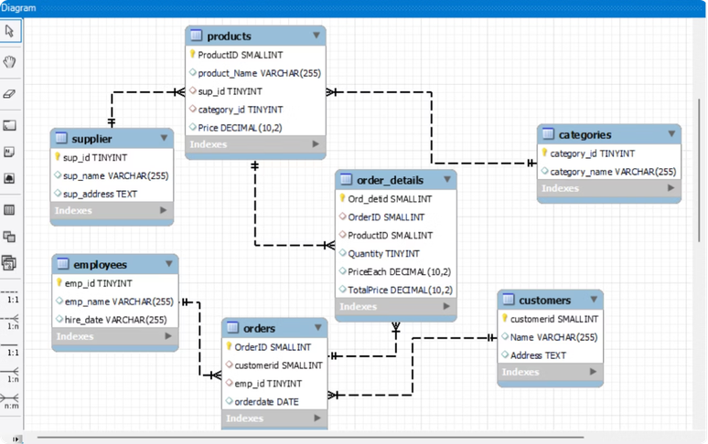
DATABASE DESIGN
Database Overview
7 interlinked tables connected via primary and foreign keys. Below is the Entity Relationship Diagram.
Customers
200 records — CustomerID, Name, Address
Orders
300 records — Order_ID, Customer_ID, Emp_ID, OrderDate
Order Details
600 records — Order_DetID, Order_ID, Product_ID, Qty, PriceEach, TotalPrice
Products / Categories / Suppliers / Employees
50 products · 5 categories · 5 suppliers · 10 employees
Notes:
2

Slide 3
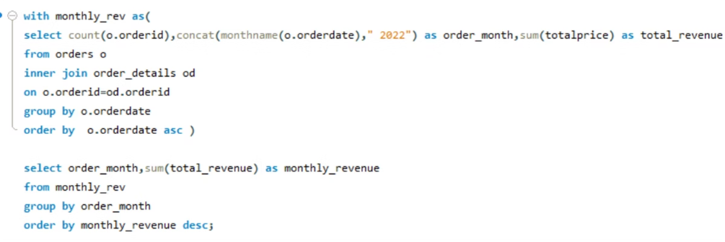
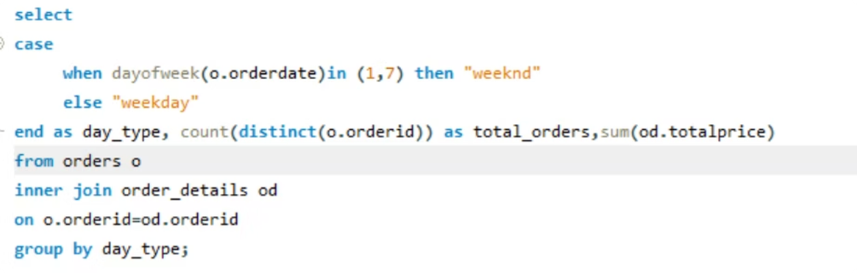
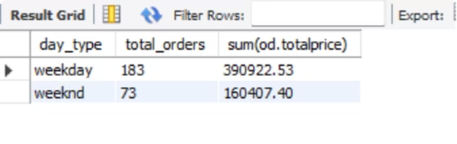
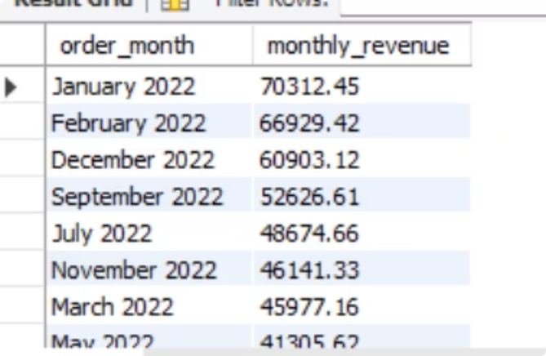
ANALYSIS 1
Sales & Orders Trends
Analyze business performance through orders and revenue over time- SQL Query
order patterns across weekdays and weekends? — Query & Result
Monthly Revenue- Result
Monthly Volume & Revenue — Query & Result
📅 Top Revenue Months
📦 Order Distribution
January 2022 (₹70,312) · February 2022 (₹66,929) · December 2022 (₹60,903)
300 total orders · Weekdays: 183 orders · Weekends: 73 orders · April, June & October saw the lowest revenue
Notes:
3

Slide 4
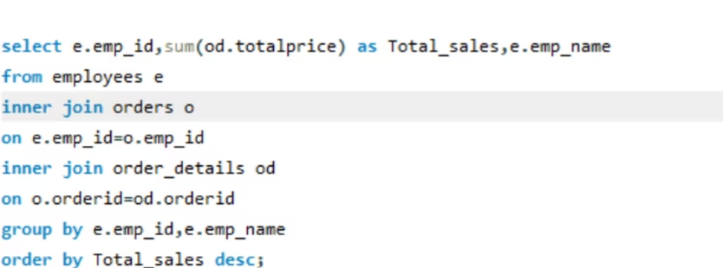
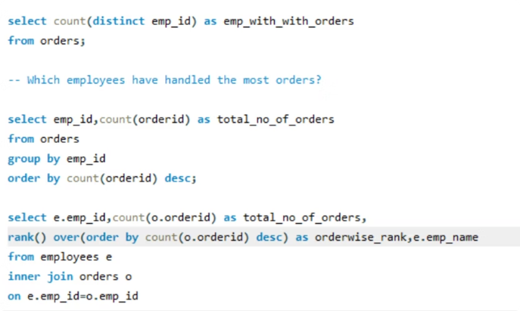
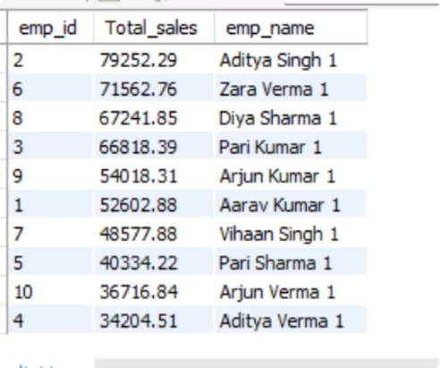
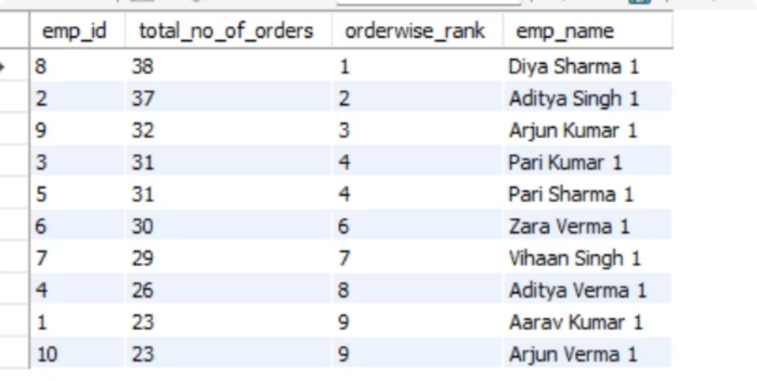
ANALYSIS 2
Employee Performance
How many employees have processed ORDERS? WHICH employees have handled the most orders? — Query
Total Sales per Employee — Query
EMPLOYEE Sales Value Result
employees handled most orders — Result
🏆 Top by Order Volume
💰 Top by Sales Value
📊 Avg Order Value/Employee
Diya Sharma (38) · Aditya Singh (37) · Arjun Kumar (32)
Aditya Singh generated the highest revenue at ₹79,252
Ranges from ₹1,554 to ₹2,768 across 10 employees
Notes:
4

Slide 5
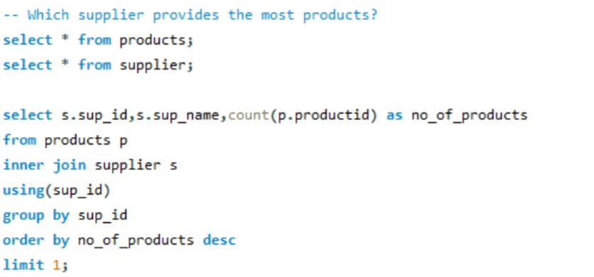
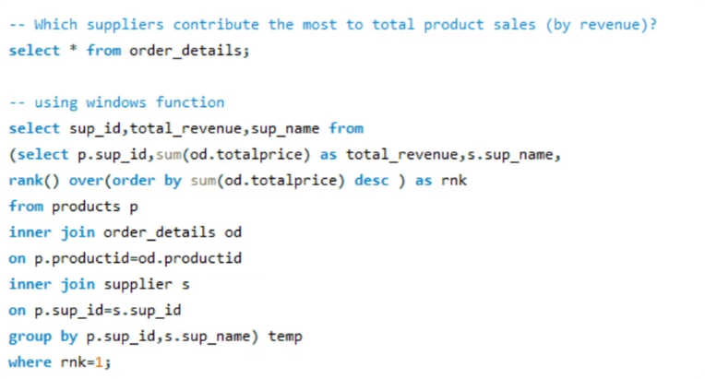
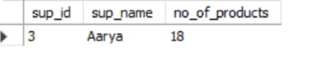
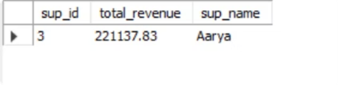
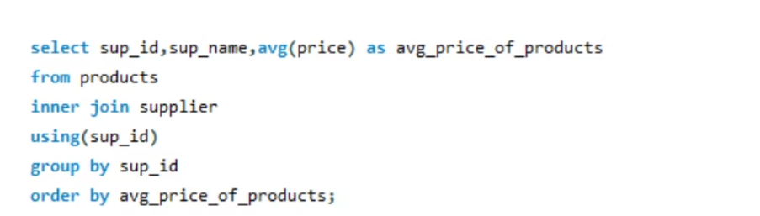
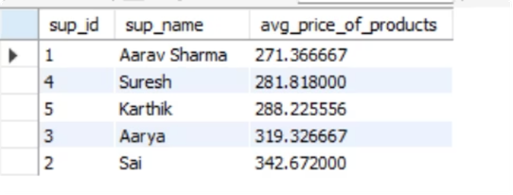
ANALYSIS 3
Supplier Analysis
supplier provides the most products? — Query & Result
Revenue by Supplier (Window Function) — Query & Result
Avg Price per Supplier — Query & Result
🏅 Most Products
💰 Highest Revenue
Aarya — 18 products
Aarya — ₹2,21,138
💸 Lowest Avg Price
💎 Highest Avg Price
Aarav Sharma (Budget-friendly)
Sai — Premium pricing
Notes:
5

Slide 6
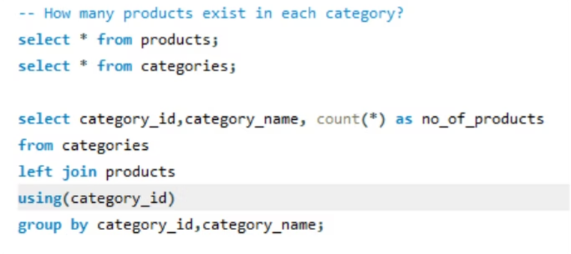
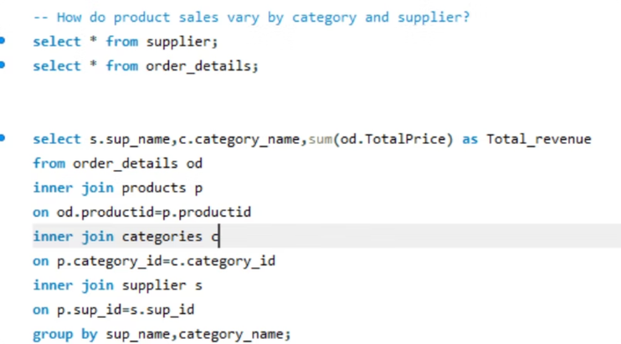
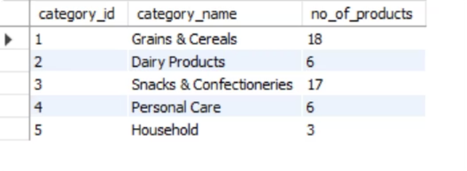
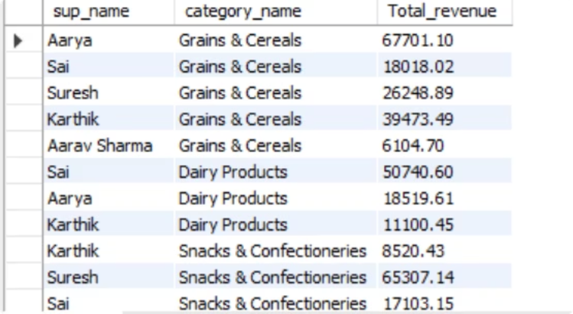
ANALYSIS 4
Product & Category Insights
Products per Category — Query & Result
Sales by Category & Supplier — Query & Result
Category Breakdown
Grains & Cereals (18) · Snacks & Confectioneries (17) · Dairy Products (6) · Personal Care (6) · Household (3)
Top Supplier per Category
Grains & Cereals: Aarya (₹67,701) · Dairy: Sai (₹50,740) · Snacks: Aarya (₹65,538) · Personal Care: Aarya (₹69,378) · Household: Karthik (₹22,767)
Notes:
6

Slide 7
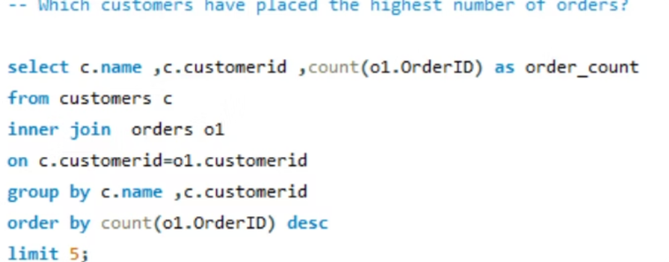
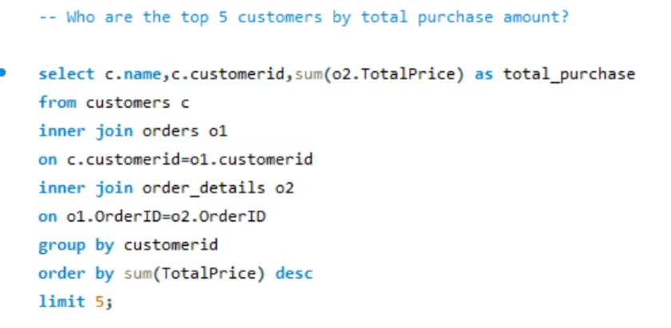
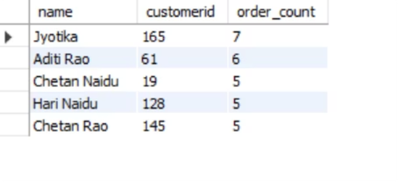
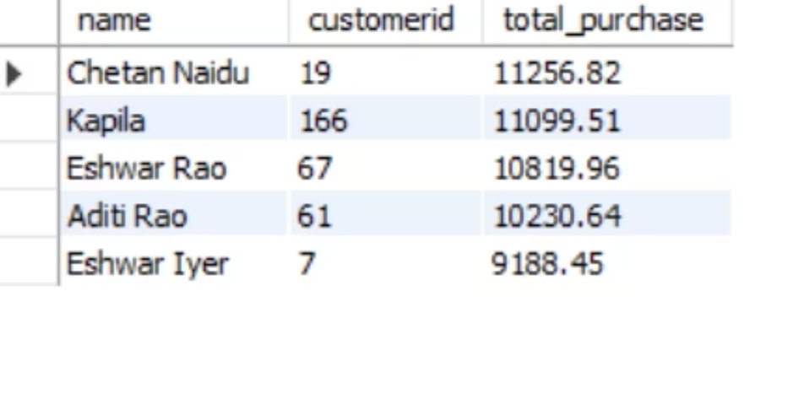
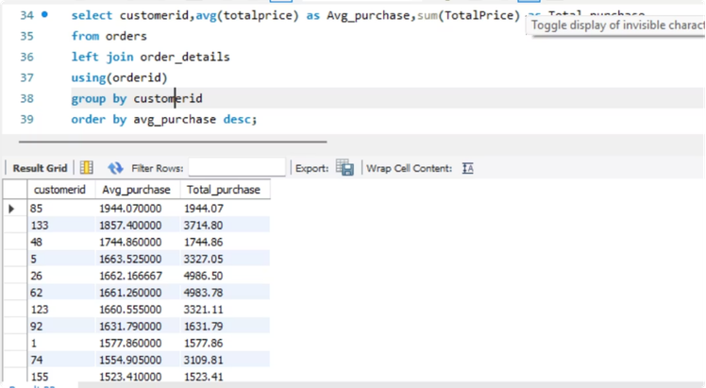
ANALYSIS 5
Customer Behavior Patterns
Top Customers by Orders — Query & Result
Top 5 Customers by Purchase Amount — Query & Result
Avg & Total Purchase per Customer — Query
👥 Active Customers
🏆 Top Buyer
156 out of 200 customers placed orders
Jyotika — 7 orders · Aditi Rao — 6 · Chetan Naidu — 5
💳 Purchase Range
Avg purchase value: ₹133.51 to ₹1,944 per customer
Notes:
7

Slide 8
SUMMARY
Key Insights
🛒 Diverse Product Portfolio
🏭 Aarya — Star Supplier
5 categories with moderate pricing. Grains & Cereals and Snacks & Confectioneries are the highest-revenue categories.
Aarya dominates across multiple categories, contributing the highest total revenue of ₹2,21,138. Sai and Karthik show category-specific strength.
👥 Mixed Customer Base
📈 Strong Growth Potential
156 active customers with wide spending variation (₹133 to ₹1,944 avg). Opportunity to increase retention and upsell.
Focusing on top-performing suppliers, high-revenue categories, and loyal customers can drive sustainable business growth.
Tools Used: MySQL Workbench | Concepts: Joins, Aggregations, CTEs, Window Functions, Subqueries
Notes:
8

